Slide 1




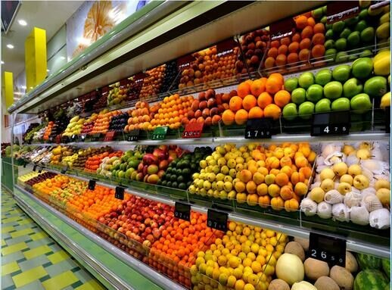
Assessing and Optimizing the Performance of
R-290 Integral Display Case

Slide 2



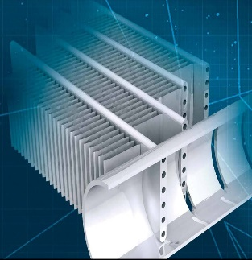

Contents
1
Introduction
2
Objectives
3
Current system Description
4
Data Analysis
5
Preliminary Simulations
6
Improvements and Suggestions
7
Inquiries
2

Slide 3
1
Introduction

Slide 4
The mission:
Assessing and optimizing the performance of the following R-290 integral display case.
The system comprises:
1 evaporator with 3 circuits of R290.
3 Copeland Scroll ZB09KAU-TFD compressors.
3 Danfoss D22-20 Micro-plate condensers.
4

Slide 5
Design point/working conditions:
Evaporation temperature: – 6 °C
Cooling capacity per compressor/circuit: 2.5 kW
Condensing temperature: 55 °C
Subcooling: 1 K
Superheat: 7 K to 10 K
Number of circuits: 3
Mass flow R-290 per circuit: 9.20 g/s
Tair,out: – 2 °C
Tair,in: 6 °C with 50% RH
5

Slide 6
2
Objectives

Slide 7
To analyze the experimental data of the current system.
To model the current system using IMST-ART simulation tool in order to assess the system performance.
To implement improvements to increase the performance while maintain the display case dimensions, such as: increasing the brine mass flow rate, reducing the number of condenser's plates, re-designing the evaporator’s circuits, etc.
7

Slide 8
3
Current system Description

Slide 9

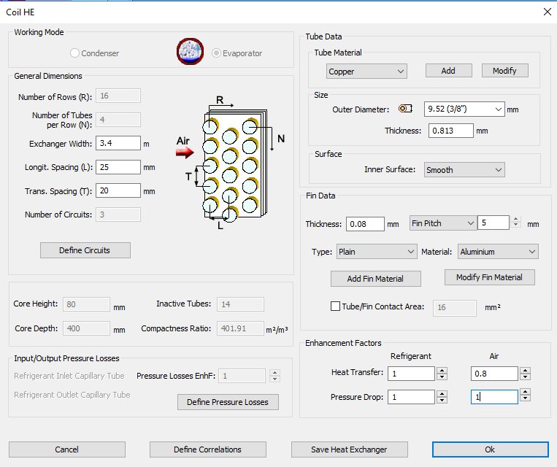
Evaporator
The current evaporator has the following dimensions:
9

Slide 10
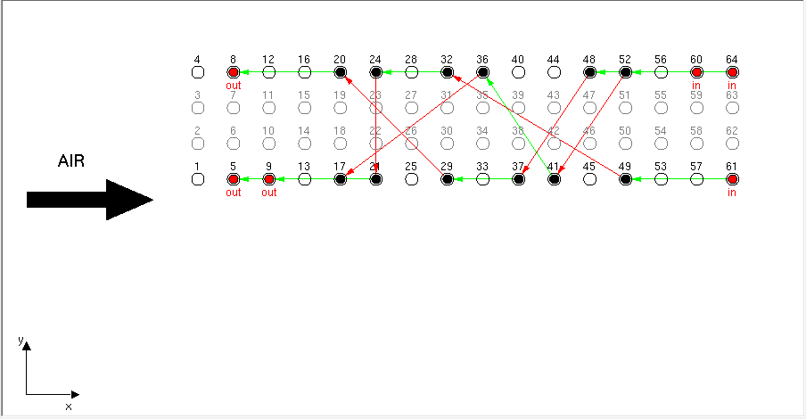
Evaporator
It has 3x 150g R290 circuits arranged as follows:
Inlet circuit 3 (C3)
Inlet circuit 2 (C2)
Inlet circuit 1 (C1)
Refrigeration Circuits by IMST-ART
10

Slide 11
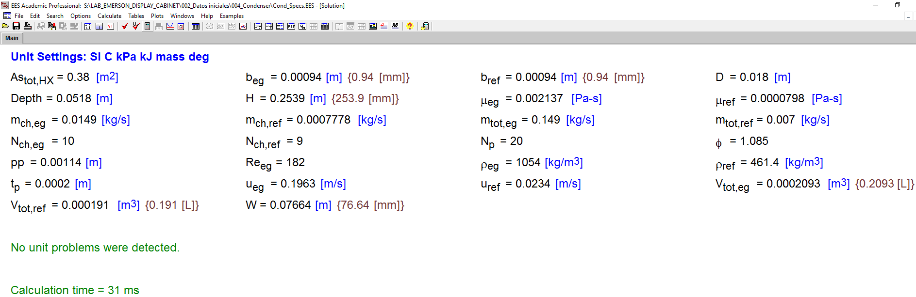
Condenser
To simulate the condenser in IMST-ART, it is required to specify the plate thickness and area enhancement factor.
With the aid of EES program and catalog data we have estimated correctly the plate thickness (2 mm) and area enhancement factor (1.085) which give quite similar effective surface area, Ethylene glycol velocity in the channel, total volume of refrigerant path, and total volume of Ethylene glycol path.
11

Slide 12
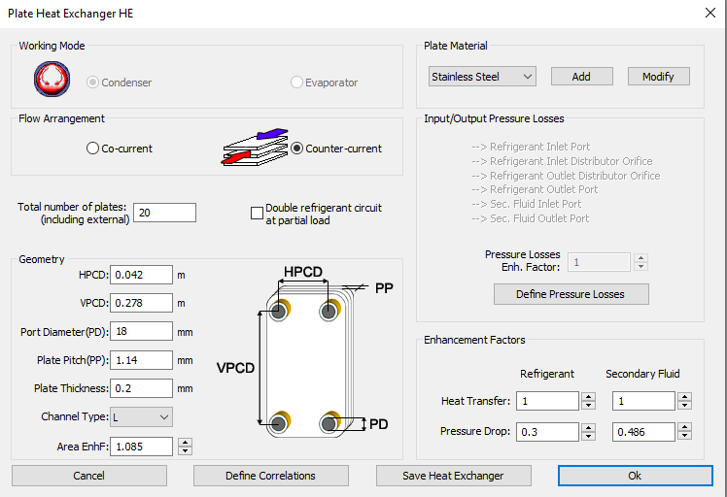
Condenser
Based on the previous analysis, The specifications of one condenser are introduced to IMST as follows:
12

Slide 13
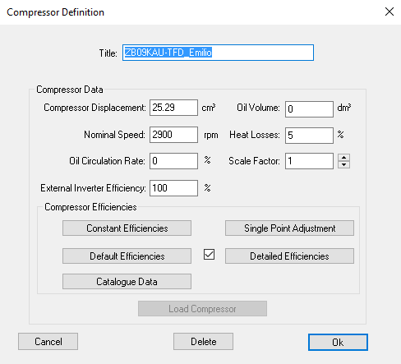
Compressor
The specifications of one compressor are:
We have assumed 0 oil volume. Because we have found that it is better to calculate the amount of refrigerant charge inside the compressor using the solubility curves.
13

Slide 14
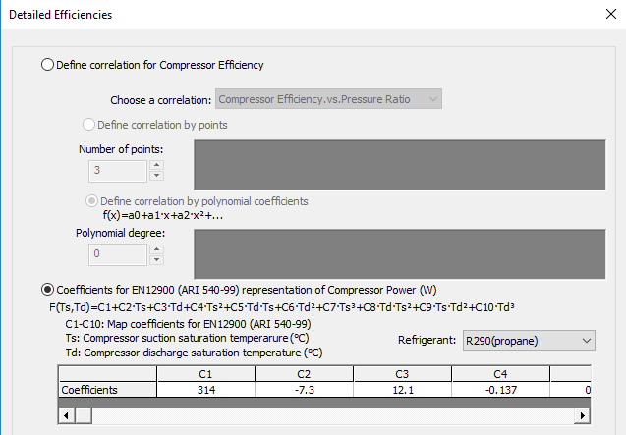
Compressor
The power correlation:
14

Slide 15
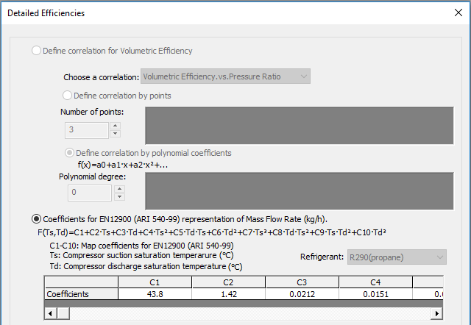
Compressor
The mass flow rate correlation:
15

Slide 16
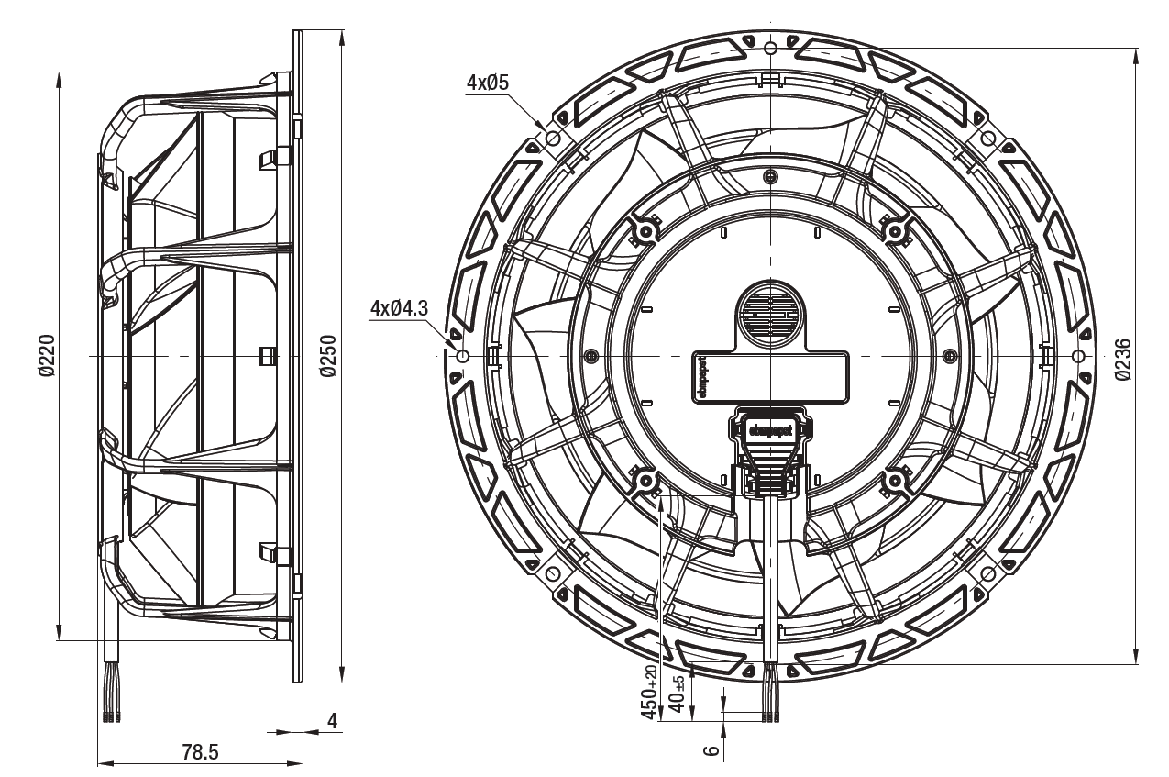
Evaporator Fans
The air flow is generated by 6 diagonal flow EC fans, model K1G-200 from EBM Papst running at 1400 rpm in the current arrangement.
The dimensions of one fan:
16

Slide 17
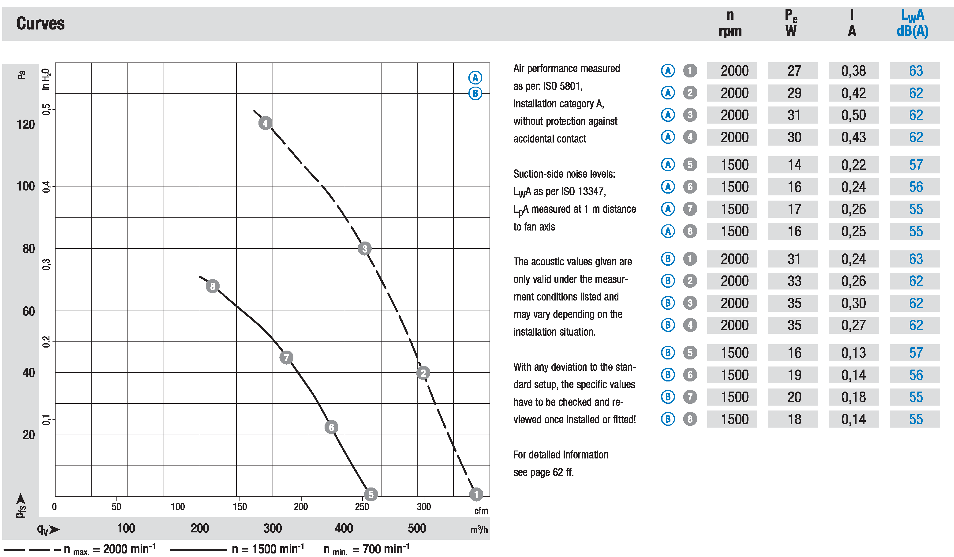
Evaporator Fans
The head vs flow rate curves are as follows:
17

Slide 18
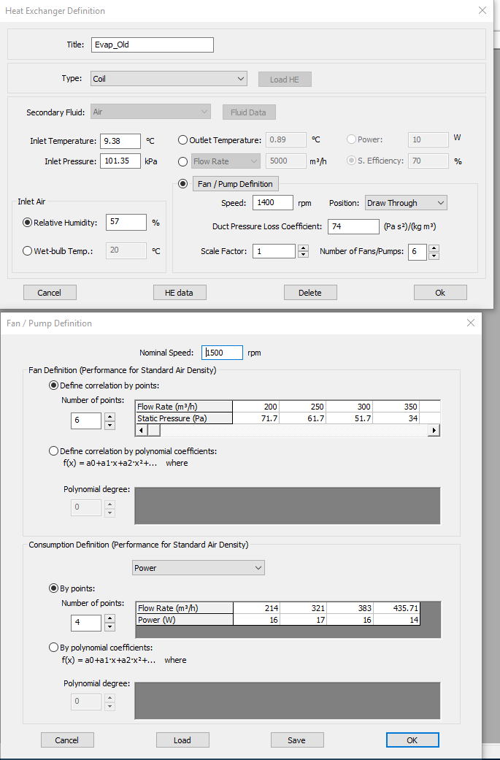
Evaporator Fans
The Fan curves are introduced to the IMST program as follows:
Static pressure VS flow rate curve
Fan power VS flow rate curve
18

Slide 19
4
Data Analysis

Slide 20
Selection of SSR
Tevap (Circuit 1)
To correctly evaluate the experimental data, We have selected a steady state range (SSR) from the experimental campaign of 200g Propane.
This range varies from 14.30 to 14.80 h which corresponds to 30 min of continuous operation.
Tevap (Circuit 2)
Tevap (Circuit 3)
20

Slide 21
Evaluation of SSR
The given data are reevaluated again based on the brine data used in condenser.
The brine used is: Termofrost E (50% Ethylene-Glycol)
We have noticed that the brine’s Cp values provided by the experimental report are a little bit low (with average value of 3.2 kJ/kg.K)
So we have recalculated them again using EES program, and the current average value is 3.4 kJ/kg.K
Based on these changes we have recalculated the Q_{cond} and h_{ref,out,cond}, which, in turn, affect the performance of the evaporator.
A sample of data is shown in the next figures.
21

Slide 22
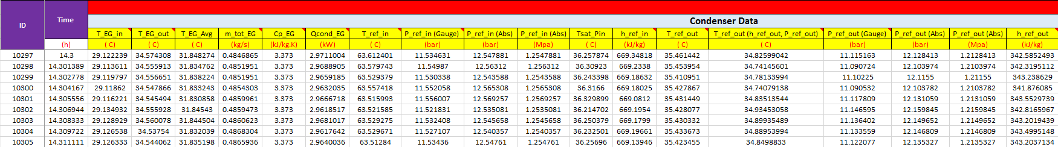
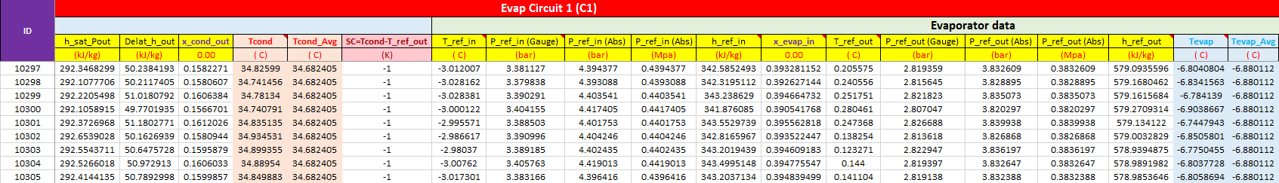
Evaluation of SSR
22

Slide 23
Analysis of Data
The following figures summarize the data for C1, C2, and C3.
The Tevap values have been recalculated again by using REFPROP, based on the outlet evaporator pressure.
It can be clearly noticed, the different behavior between C1 and C3, and C2, which has a lot of fluctuations.
23
Notes:
There is a different behavior between the circuit 1 and 3 and the circuit 2. a lot of fluctuation

Slide 24
Analysis of Data
The Tcond values have been recalculated again by using REFPROP, based on the outlet condenser pressure.
It can bee seen, the large fluctuations in Tcond for C2 compared to C1 and C3.
Additionally, there is approximately 5 ^{O}C difference between the average condensation temperatures for C1 and C3 and average condensation temperature for C2.
24

Slide 25
Analysis of Data
To confirm the presence of SC, we have calculated the difference between the outlet enthalpy from condenser and its corresponding saturated enthalpy.
It can be noticed that for C1 and C3 there is no SC, while C2 has big fluctuation in SC values which range between no SC to 13 K SC.
The estimated average value of condenser outlet quality for C1 and C3 is 0.16.
25

Slide 26
Analysis of Data
The SH values have been evaluated as the difference between the outlet evaporator temperature and evaporation temperature.
26
Notes:
The same trend observed with th econdensing and the evaporating temperature.

Slide 27
Summary
The high SC values (up to 12 K) indicate that C2 is overcharged.
Large fluctuations in SC and SH values for C2 (more than 10 K) can be observed from the previous figures.
The enthalpy analysis shows that C1 and C3 are undercharged.
These observations could indicate that the selected expansion valve is oversized.
27

Slide 28
5
Preliminary Simulations

Slide 29
SSR IMST-ART Simulation
We have used the following parameters as inputs to the IMST-ART simulation program:
IMST inputs
Condenser
EG | T_EG_in (Avg.) | 29.2 | ºC
 | T_EG_out (Avg.) | 34.8 | ºC
Evaporator
Air | T_air_in (Avg.) | 9.4 | ºC
 | T_air_out (Avg.) | 0.89 | ºC
 | RH_air_in (Avg.) | 57 | %
Ref | SH (Avg.) | 5.3 | K
These parameters represent the average values for the three circuits.
29

Slide 30
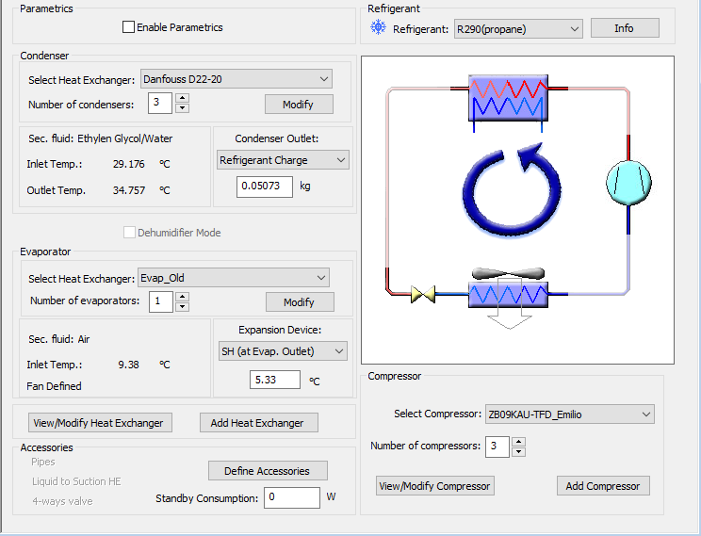
SSR IMST-ART Simulation
The following figure shows the general layout of system simulation on IMST-ART.
This charge is dedicated only to the condensers and evaporator.
30

Slide 31
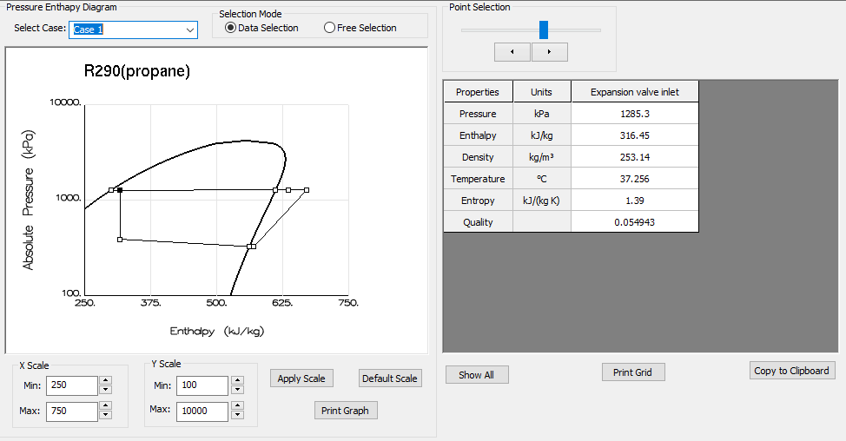
SSR IMST-ART Simulation
We have assumed that the refrigerant charge is the variable of the problem in order to obtain the experimental value of the average outlet enthalpy from the condenser.
To achieve the required outlet enthalpy (316.45 kJ/kg), the refrigerant charge has been fixed at (50.73 g)
31

Slide 32
SSR IMST-ART Simulation
The simulation results are summarized next:
Comparison between Exp. and Num. Results
Condenser
Exp. |  |  | Num. | Dev % | Notes
Qcond | kW | 9.6 | 8.4 | -12.5
h_ref_out | kJ/kg | 316.46 | 316.45 | -
Tcond | ºC | 36.46 | 37.26 | 2.2
T_ref_in | ºC | 65.2 | 64.67 | -0.81 | These deviations are resulted from the large fluctuations in circuit 2.
T_ref_out | ºC | 34.4 | 37.26 | 8.31
ΔP_ref | kPa | 25 | 0.6 | -97.6 | We think that the numerical value is more accurate, because it is more consistent with the catalog data.
m_EG_total | kg/s | 0.51 | 0.45 | -11.8
Evaporator
Qevap | kW | 7 | 6 | -14.3
Tevap | ºC | -7.05 | -11.4 | 61.7 | These notable deviations could be related to the large fluctuations in circuit 2.
T_ref_in | ºC | -3.41 | -6.03 | 76.8
T_ref_out | ºC | -1.72 | -6.07 | 253
ΔP_ref | kPa | 54 | 64 | 18.5
32

Slide 33
Air Flow Rate and Pressure Drop
Based on fans specifications and speed, IMST program estimated the required air flow rate, pressure drop through evaporator, and pressure drop through flow ducts.
IMST Results Based on Fans Specifications and Speed of 1400 RPM
Evaporator
Air Mass Flowrate | 0.53 | kg/s
ΔP_air_Evap | 38.18 | Pa
Air Face Velocity | 1.58 | m/s
Air Flowrate | 1545.1 | m³/h
Fan Duct Pressure Loss Coefficient | 74 | (Pa.s²)/(kg.m³)
Fan Duct Pressure Loss | 16.39 | Pa
33

Slide 34
Refrigerant Charge Analysis
Based on numerical simulations, the refrigerant charge is distributed as follows:
Refrigerant Charge Distribution (g)
Component | m_ref (g) | Notes
Evaporator | 15.8
Condensers’ Channels | 35
Condensers’ Outlet Headers | 11.4 | Calculated from the header specifications in condenser’ catalog.
Compressors | 54.7 | Calculated from the Solubility curves provided by Emerson. The oil sump temperature has been estimated using correlation proposed by Navarro et al. (2012)*
Liquid Line (3 circuits) | 25.3 | From the data provided by Emerson.
Total | 142.2
* Navarro E., Corberán J.M., Martínez-Galvan I.O., Gonzálvez J. 2012. Oil sump temperature in hermetic compressors for heat pump applications. International Journal of Refrigeration, 35, 397-406
34

Slide 35
Summary
The numerical results show good agreement with the experimental data. IMST over-predicted the condensation temperature by 0.8 ºC, and under-predicted the evaporation temperature by 4.4 ºC. These deviations could be resulted from the large fluctuations in experimental data.
It can be clearly noticed that the outlet of condenser, based on the given data, is always inside the mixture zone. This could affect a lot the system performance.
The evaporator’s refrigerant-side and air-side pressure drops , 64 kPa and 38.2 Pa respectively, are not so large and are within the acceptable range.
35
Notes:
* We still need a comment on the charge

Slide 36
6
Improvements and Suggestions

Slide 37
Flow Rate of Condenser’s Brine
We have implemented a parametric study to evaluate the effect of brine’s flow rate on the system performance.
In this study, we have assumed same refrigerant charge, number of condenser plates, and fan speed, as the original system configurations.
The next table show the results of this study.
37

Slide 38
Flow Rate of Condenser’s Brine
It can be seen from these figures, that increasing the flow rate of brine results to a decrease in condensation temperature up to 2.1 ºC.
On the other hand, this has a negligible effect on the evaporation temperature, with a maximum decrease of 0.2 ºC.
38

Slide 39
Flow Rate of Condenser’s Brine
This figure shows that increasing the flow rate of brine results to an increase in the COP_aux (which includes all the auxiliaries of the system such as brine pump, etc.).
The enhancement of the COP_aux of the system is up to 5.3%.
39

Slide 40
Number of Condenser’s Plates
In this study, we have reduced the number of condenser’s plates gradually to evaluate its effect on the refrigerant charge and condensation temperature.
We have assumed same fan speed as original system.
The results are summarized on the next figures.
From 20 to 16 plates
40

Slide 41
Number of Condenser’s Plates
It can be seen that decreasing the number of condenser´s plates results to an increase in condensation temperature up to 1.74 ^{O}C.
Decreasing the number of plates to 16, results to a small increase in condensation temperature by 0.7 ºC.
41

Slide 42
Number of Condenser’s Plates
It can be noticed that decreasing the number of condenser´s plates results to a decrease in refrigerant charge up to 14 g.
Decreasing the number of plates to 16, results to a decrease in refrigerant charge by 7 g.
42

Slide 43
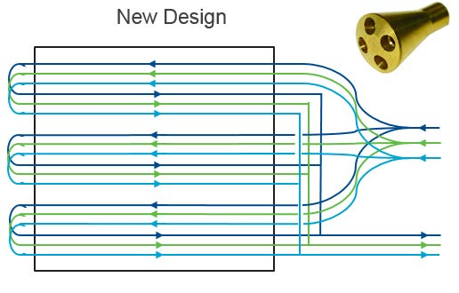
Configuring the evaporator circuits
We have evaluated numerically the new configuration (9-circuits evaporator) proposed by Emerson for the current evaporator.
43

Slide 44
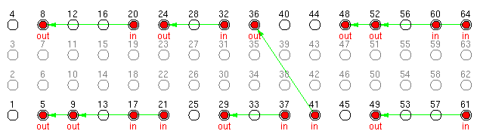
Configuring the evaporator circuits
The 9 refrigerant circuits are introduced to the IMST program as follows:
Air
We have assumed same refrigerant charge, brine flow rate, air flow rate as the original system.
The results of comparative study between the 9-circuits configuration and original one are shown next.
44

Slide 45
Configuring the evaporator circuits
Comparative study between original and 9-circuits evaporators
Condenser
Parameter | Unit | Original Evaporator | 9-circuits Evaporator | Dev% | Difference
h_ref_out | kJ/kg | 316.44 | 301.19 | -4.8 | -15.3
Tcond | C | 37.256 | 37.95 | 1.9 | 0.702
T_eg_out | C | 34.757 | 35.1 | 1 | 0.35
Evaporator
Tevap | C | -11.4 | -10.9 | -4.5 | 0.51
ΔP_ref | kPa | 63.8 | 4 | -93.8 | -59.8
T_air_out | C | 0.89 | 0.26 | -70.5 | -0.63
Global
COP_aux | - | 2.3 | 2.5 | 6.7 | -
Qevap | kW | 6 | 6.5 | 8.2 | 0.5
Qcond | kW | 8.4 | 8.9 | 6.3 | 0.5
45

Slide 46
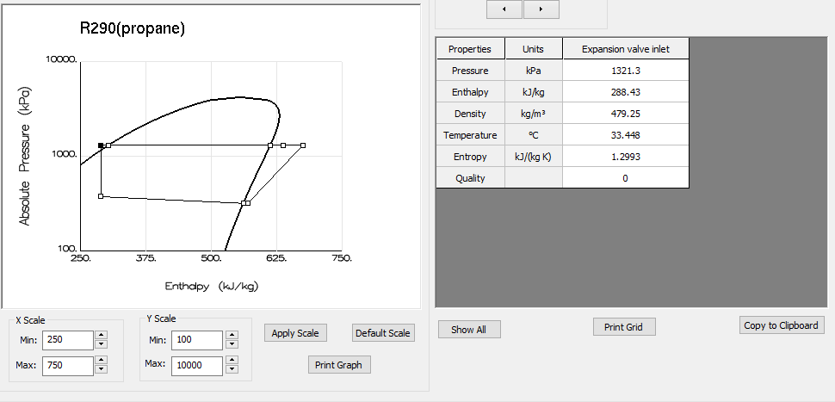
5K of Subcooling
In this study we have evaluated the current system subjected to 5 K of subcooling.
We have assumed same number of condenser's plates, fan speed, inlet and outlet brine temperatures, SH as the original system.
The results of the comparison between the two systems are summarized next.
46

Slide 47
5K of Subcooling
Comparative study between original and 5K SC systems
Condenser
Parameter | Unit | Original System | 5K SC System | Dev% | Difference
h_ref_out | kJ/kg | 316.44 | 288.43 | -8.9 | -28.01
Tcond | C | 37.256 | 38.45 | 3.2 | 1.19
m’_eg | Kg/s | 0.45 | 0.47 | 5.45 | 0.02
Evaporator
Tevap | C | -11.4 | -12.2 | 6.92 | -0.8
ΔP_ref | kPa | 63.8 | 56.55 | -11.42 | -7.25
Global
m_ref | g | 50.7 | 85.6 | 68.8 | 34.9
COP_aux | - | 2.3 | 2.44 | 4.57 | -
Qevap | kW | 6 | 6.4 | 6.74 | 0.4
Qcond | kW | 8.4 | 8.8 | 5.45 | 0.4
47

Slide 48
Further Suggestions
Increasing the fans’ speed
Using water as secondary fluid in the condensers instead of Ethylene Glycol.
New configurations for the evaporator (more tube rows, staggered arrangement, etc.)
48

Slide 49
Summary
Increasing the brine flow rate is a good improvement to the system, the results show that increasing the flow rate by 67% could results to an increase in the COP_aux by 5.3%; additionally, it results to a decrease in condensation temperature by 2.1 ºC.
Reducing the number of condenser plates to 16 plates results to a decrease in refrigerant charge by 7g; on the other hand, it has a negligible effect in condensation temperature (0.7 ºC increase in Tcond).
The new evaporator configuration (9-circuits) results to a notable decrease in refrigerant-side pressure drop by 94%, and to an increase in COP_aux by 6.7%.
applying a 5 K of SC is another way to improve the system performance. The results show that the presence of 5 K of SC results to an increase on refrigerant charge by 35 g. On the other hand, this results to an improvement in COP_aux by 4.6%.
49

Slide 50
7
Inquiries

Slide 51
To obtain an accurate evaluation of the system, we need some further information.
Our main inquires are listed below:
We need to validate the compressor correlations with some experimental data points, please could you provide us with this data?
51

Slide 52
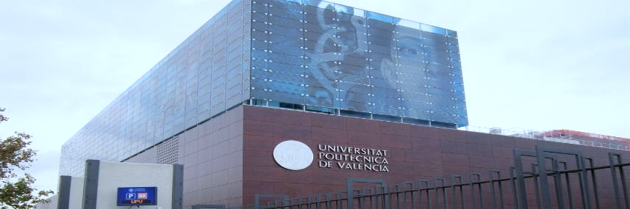


Thanks for Your Attention
Notes:
* And I´m I looking forward for your questions and inquiries.

